Slide 1
Bipolar Junction Transistors – BJT’s
Fundamentals
  Definition: A three terminal device based on minority carrier injection into a reversed biased p-n junction
  Recall that current thru a p-n junction is based on minority carriers that are generated near the physical junction
  To increase current flow, one must increase minority carrier generation
    accomplished by EHP generation
    can be performed optically or electrically
  Electrical generation?
    Use a p⁺-n junction that is forward biased as a source of holes for a reversed biased n-p junction
    basically the device is a p⁺-n junction back-to-back with an n-p junction, sharing the n layer between them

Slide 2
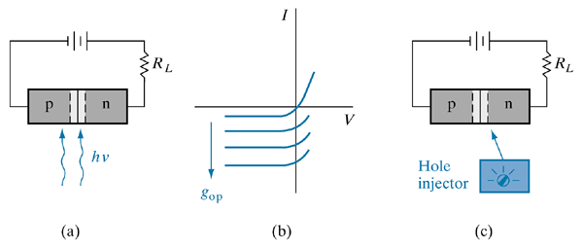
External control of the current in a reverse-biased p-n junction:
optical generation;
junction I–V characteristics as a function of EHP generation;
(c) minority carrier injection by a hypothetical device.

Slide 3
BJT’s
Basic Structure: See Figure 7-2
  p⁺ layer is called the emitter
  p layer is the collector
  n layer is the base
  The configuration shown in Fig 7-2 is called the common base configuration.
Key features of a BJT in making it work well
  n region
    must be narrow
    minority carrier lifetime must be long
  I_{E} must consist mostly of holes
    n region must be lightly doped

Slide 4
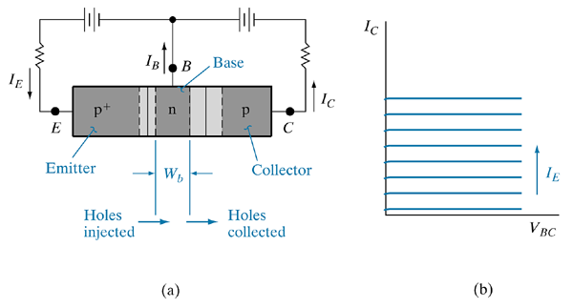
A p-n-p transistor
schematic representation of a p-n-p device with a forward-biased emitter junction and a reverse-biased collector junction;
I–V characteristics of the reverse-biased n-p junction as a function of emitter current.

Slide 5
Notes on 15th April
Bjt is minority carrier device.
p+ - lots of holes – using FB, we accelerate holes to n region of base and use RB to accelerate those holes into collector region
The Wb is a parameter of importance
FB – thin depletion region
RB – thick depletion region
The optical bit from previous fig : as the optical illumination increases the current in rb increases, because they are more and more charges generated that are pulled into rb

Slide 6
BJT’s
Current Flow in a BJT
  See Fig 7-3
  i_{E} and i_{C} consist of holes
  What about i_{B}?
    it is “made up” of components from three sources
      recombination of holes with electrons will occur in the n region, so electrons will flow in from the base terminal
      electrons will flow from the n region to the p⁺ region in the forward biased junction, so electrons will flow into n from the base terminal
      electrons will flow into the n region from the reversed biased junction, decreasing the number of electrons flowing in from the base terminal.
    Net effect: i_{B} consists primarily of electrons.
What about n-p-n transistors?
  Current flow is reversed since electrons (not holes) flow from emitter to collector. Also i_{B} consists of holes

Slide 7
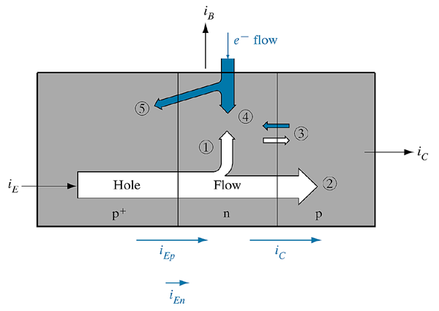
Flow in a p-n-p transistor with proper biasing: (1) injected holes lost to recombination in the base; (2) holes reaching the reverse-biased collector junction; (3) thermally generated electrons and holes making up the reverse saturation current of the collector junction; (4) electrons supplied by the base contact for recombination with holes; (5) electrons injected across the forward-biased emitter junction.

Slide 8
BJT’s
Amplification with BJTs
  General Principle: Collector and emitter currents are controllable with a very small base current.
  Amplification works for d-c and small, low frequency a-c signals.
Current Relationships
  Assumptions
    in a p-n-p junction, holes injected into the base are not recombined in this region
  Collector current (i_{c})
    Base transport factor (B)
    emitter injection efficiency (γ)
    B + γ = 1 for ideal BJT
    current transfer ratio (α)

Slide 9
BJT’s
Amplification mechanisms
  occurs with respect to i_{B}
  i_{B} dynamics
    i_{B} consists of electrons from the base terminal resulting from several events in the n-type region. i_{B} is determined by the rate of these events
      rate at which electrons are lost by injection from the n-type region across the emitter junction
      rate of recombination with holes in the base
    If B is the fraction of holes (for p-n-p BJT) in the n region, then
    i_{B} = i_{En} + (1-B)i_{En}
    i_{C}/i_{B} = α/(1 - α) = β
  β is called the “base-to-collector current amplification factor”
  Since α ~ 1, β is a large value

Slide 10
BJT’s
The Common Emitter Circuit
  See Fig 7-4
  i_{B} is used to determine the magnitude of i_{C}
  How?
    The n-type region within W_{b} is neutral
      holes moving from the emitter to the collector cause electrons to flow into the base at W_{b} in order to maintain space-charge neutrality
      There is not a 1-to-1 recombination of electrons and holes in this region due to differences in transit and lifetimes.
      These differences indicate that as i_{B} decreases so does i_{C}
      But aren’t they independent?
      From a space-charge point of view, not really.
        As i_{B} decreases, holes accumulate in the base
        a net repulsive positive charge builds up as space-charges
        this leads to a positive bias that serves to reduce i_{C}

Slide 11
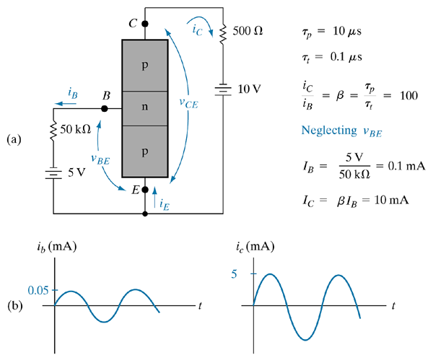
Example of amplification in a common-emitter transistor circuit: (a) biasing circuit; (b) addition of an a-c variation of base current i_{b} to the d-c value of I_{B}, resulting in an a-c component i_{c}.

Slide 12
BJT’s
Characteristics of the Common Emitter Circuit
  emitter electrode is common to the base and collector electrodes
  the voltage drop across the forward-biased emitter is small
  most of the voltage is dropped across the reversed biased collector
Minority Carrier Distributions in BJTs
  As with p-n junctions, these govern operation
  From an engineering perspective, we are interested in the emitter, collector and base currents.
  How do we calculate them?
    Solve for the minority carrier distribution in the base (its narrow)
    Calculate the emitter and collector currents from the gradient distributions on each side of the base
    Calculate the base current from the other two.

Slide 13
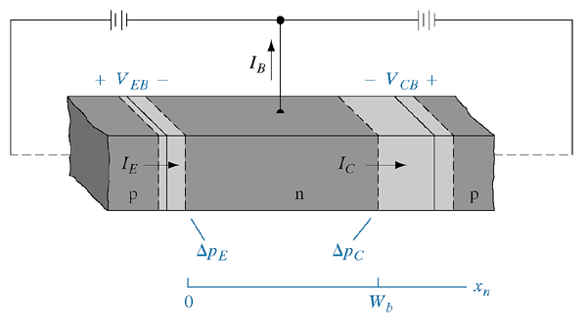
Simplified p-n-p transistor geometry used in the calculations.

Slide 14
BJT’s
  Assumptions in the calculations
    the base is narrow --> minority carriers make it across
    minority carriers move by diffusion only
    the emitter current is made entirely of minority carriers
    the collector saturation current is negligible
    current flow in one-dimensional
    all currents and voltages are in the steady state
  To do the calculations:
    define the boundary conditions
    determine the excess minority carrier concentrations at the two edges of the base
    Solve the steady-state diffusion equation (Chapter 4) with the appropriate concentrations and boundary conditions.

Slide 15
BJT’s
Coupled Diode Model
  A generalized approach which accounts for all combinations of emitter and collector bias
  Useful in understanding switching applications where normal biasing is violated.
Generalizations
  If collector junction is forward biased Δp_{c} is not 0.
  If both junctions are forward biased, Δp_{c} and Δp_{E} are positive.
  One can represent the hole distribution in the n-type region graphically as in Fig. 7-9.
    Fig 7-9a: overall hole distribution
    Fig. 7-9b: hole composition due to injection
    Fig. 7-9c: hole composition due to forward biased collector junction

Slide 16
BJT’s
Currents
  I_{EI} and I_{CI} represent current injection in the “inverted” mode
    from collector to emitter
  I_{EN} and I_{CN} represent current injection due to normal mode
    from emitter to collector
Total Currents (I_{E} and I_{C})
  Represented as the superposition of the relevant components
    I_{E} = I_{EN} + I_{EI}
    I_{C} = I_{CN} + I_{CI}
  These expressions are called the Ebers-Moll Equations
    Relevance - The E-M equations resemble diode equations with a coupling term that links the properties of the emitter and collector.
    Hence the name “coupled-diode” analysis

Slide 17
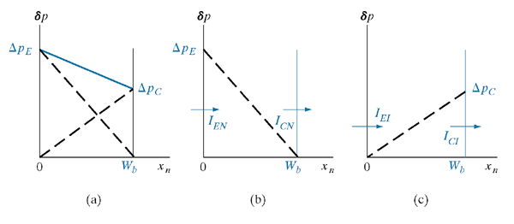
Evaluation of a hole distribution in terms of components due to normal and inverted modes:
approximate hole distribution in the base with emitter and collector junctions forward biased;
component due to injection and collection in the normal mode;
component due to the inverted mode.

Slide 18
BJT’s
The E-M equations another way
  The E-M equations can be written in the form that describes the currents in terms of a simple diode plus a current generator
    The current generator is proportional to the other current, hence maintaining the coupling characteristic.
  This allows for equivalent circuits to be constructed for BJT’s
    see Figs 7-10 and 7-11.

Slide 19
BJT’s
Switching
  transistors are commonly used as switches
  they don’t function as ideal switches
    they aren’t shorted in the “on” state and open in the “off” state.
  Common-emitter configuration
    i_{C} is controlled by i_{B} over most I-V curves
    in normal active mode, i_{B} is such that the operating point lies on the load line between the end-points: “on” state
    for i_{B} either zero or negative, i_{C} is negligible: “off” state.
      Called cut-off
    Maximum “on” state i_{C} value allowed by the load line is at maximized --> large i_{C} for small V_{CE}
      called saturation

Slide 20
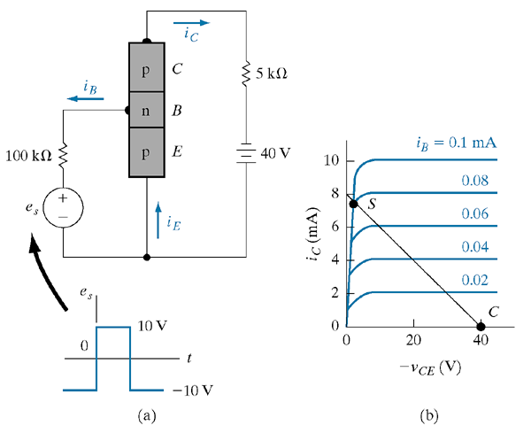
Simple switching circuit for a transistor in the common-emitter configuration:
biasing circuit;
(b) collector characteristics and load line for the circuit, with cutoff and saturation indicated.

Slide 21
BJT’s
Typical switching operations
  base current driven from positive to negative
  device goes from saturation to cut-off.
Cutoff
  at cutoff, a small saturation current flows from the n to the p region in each of the reversed biased junctions. This current is associated with i_{B}
  Hole concentration relationships for reversed biasing in the cutoff regime (i_{B} is negative):
  Current relationships (from E-M model):
    for I_{ES} and I_{CS} small and α_{N} and α_{I} ~ 1, the base, collector and emitter currents will be small and thus the BJT will approximate an off switch.
  Equivalent Circuit (Fig 7-45).

Slide 22
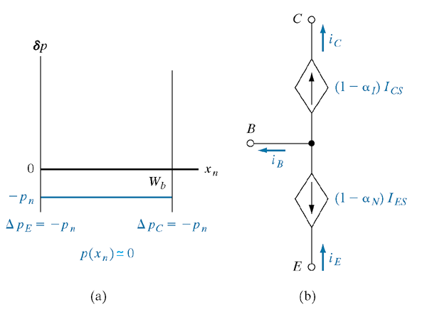
The cutoff regime of a p-n-p transistor:
excess hole distribution in the base region with emitter and collector junctions reverse biased;
(b) equivalent circuit corresponding to Eq. (7–45).

Slide 23
BJT’s
Saturation
  Begins when the reverse bias across collector junction goes to zero and continues as collector becomes forward biased.
  Hole concentrations:
    saturation begins when Δp_{C} = 0 and continues as it becomes positive
  Effects
    as emitter junction is forward biased and collector junction reaches saturation, voltage drop across BJT is small. Thus most of voltage in the circuit is dropped elsewhere.
    As the BJT is driven deep into saturation, collector current stays constant, so voltage drop doesn’t change much.
    From a voltage drop perspective, oversaturation isnt bad.

Slide 24
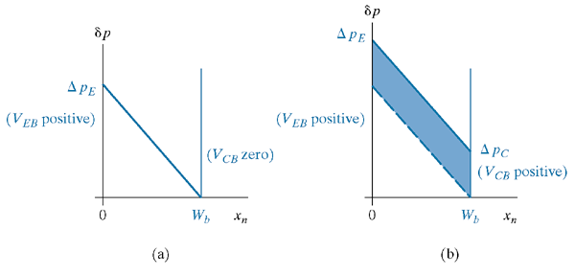
Figure 7—14
Excess hole distribution in the base of a saturated transistor: (a) the beginning of saturation; (b) oversaturation.

Slide 25
BJT’s
Switching
  Switching of a BJT is governed by stored charge and the time it takes for it to dissipate.
  Analysis follows from the transient analysis for p-n junctions.
  Represented graphically in Fig 7-15.
    At t₀ the BJT is in cutoff
    At t_{s} it hits saturation and at t₂ it is in oversaturation
    during rise to saturation, charge is stored in the base, Q_{b,}which has a saturation value of Q_{s}
        For Q_{b} < Q_{s} the current I_{C} is rising, after which it is stable.
        When I_{B} switches to negative (cut-off), I_{C} remains constant until Q_{b}reaches Q_{s}
        When not constant, I_{C} rises and falls with an exponential dependence.

Slide 26
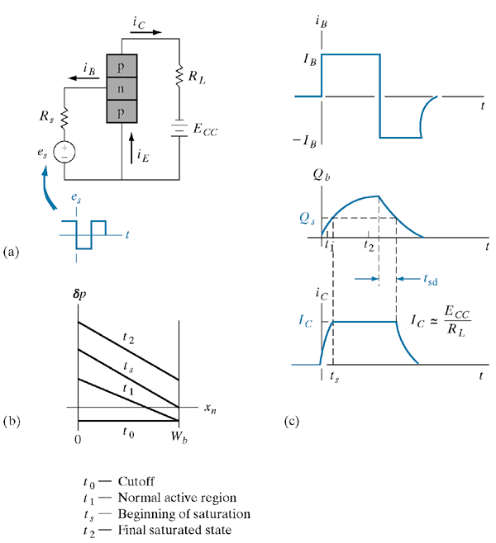
Switching effects in a common-emitter transistor circuit: (a) circuit diagram; (b) approximate hole distributions in the base during switching from cutoff to saturation; (c) base current, stored charge, and collector current during a turn-on and a turn-off transient.

Slide 27
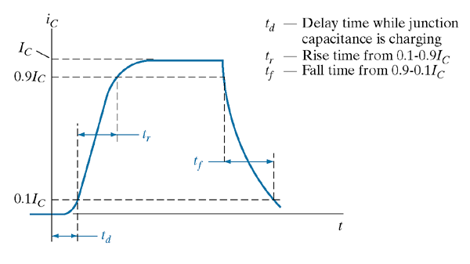
Collector current during switching transients, including the delay time required for charging the junction capacitance; definitions of the rise time and fall time.

Slide 28
BJT’s
Reality in BJT’s
  Drift in the base region
    we assumed it didn’t happen, but it does when devices are made using ion implantation
    due to doping gradients resulting in graded junctions
    graded junctions result in the creation of a built-in electric field.
      Given by Eq 7-47 thru 7-49
    E fields result in drift
    Drift aids in the transport of minority carriers across the base
  Base Narrowing
    in heavily doped emitters/collector combinations, W_{b} can extend deep into the base and its dimensions can have a voltage dependence.
    This leads to an increase in I_{C} with V_{BC} by Eq 7-50
    If the effect is great enough, punch thru can occur.

Slide 29
BJT’s
  Avalanche Breakdown
    usually prohibits punch thru from occurring
    Occurs more readily in the common-emitter configuration than common-base
  Thermal effects
    Manifests for high injection levels
    Due to power dissipation in the device
      Temperature dependences
        lifetimes increase with temp due to thermal reexcitation
        mobilities decrease due to increased lattice scattering
        D’s generally decrease with increasing temperature
      Lifetime increases dominate
      Can lead to generation of a runaway current which can permanently damage a device

Slide 30
BJT’s
HBT’s
  Heterojunction Bipolar Transistors
  For high frequency devices
  Advantage
    overcomes the issues related to doping of emitter, base and collector
      Best devices for high frequency use would have heavily doped base and lightly doped emitter and collector
        Heavy base doping leads to lower resistance.
      Is the opposite of what we have been talking about
    Heterojunctions bypass this problem altogether by taking advantage of band-gap differences
      Takes advantage of differences in barrier heights for injection of minority carriers
      See Fig 7-26 for n-p-n vs HBT
  Common materials: Si/SiGe, AlGaAs/GaAs

